Slide 1
In The Old Asylum
A Slide Show by David Beales

Slide 2
A new admission is introduced to the ward. Patients are woken at seven an hour before breakfast which is brought to the ward in a trolley from the kitchen.

Slide 3
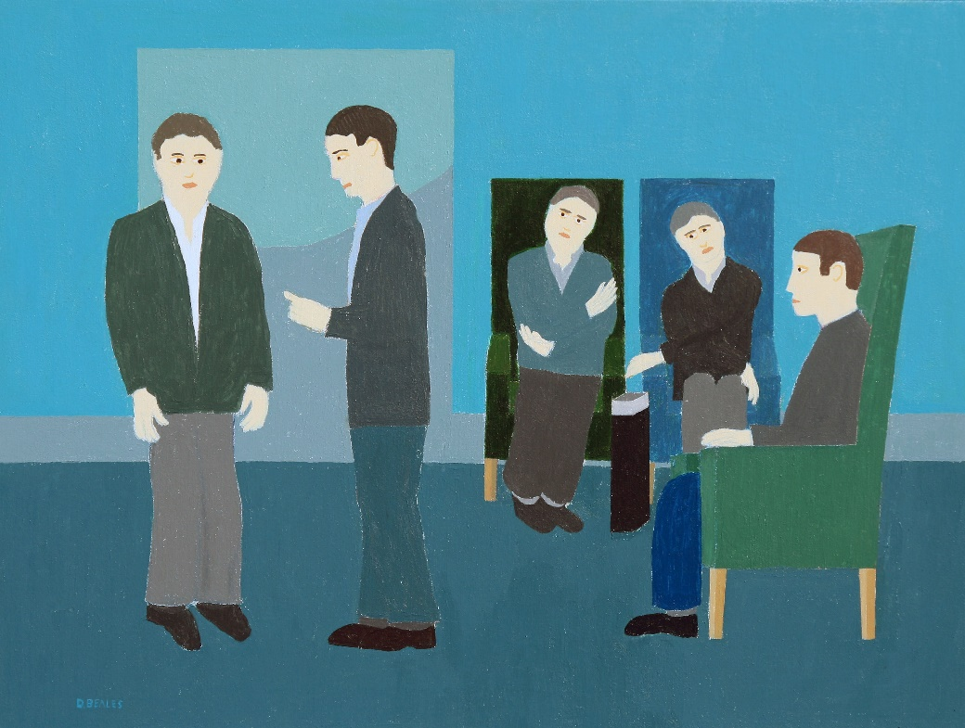

Slide 4
Nurses and domestic staff talk in the corridors while two patients plan their escape.

Slide 5
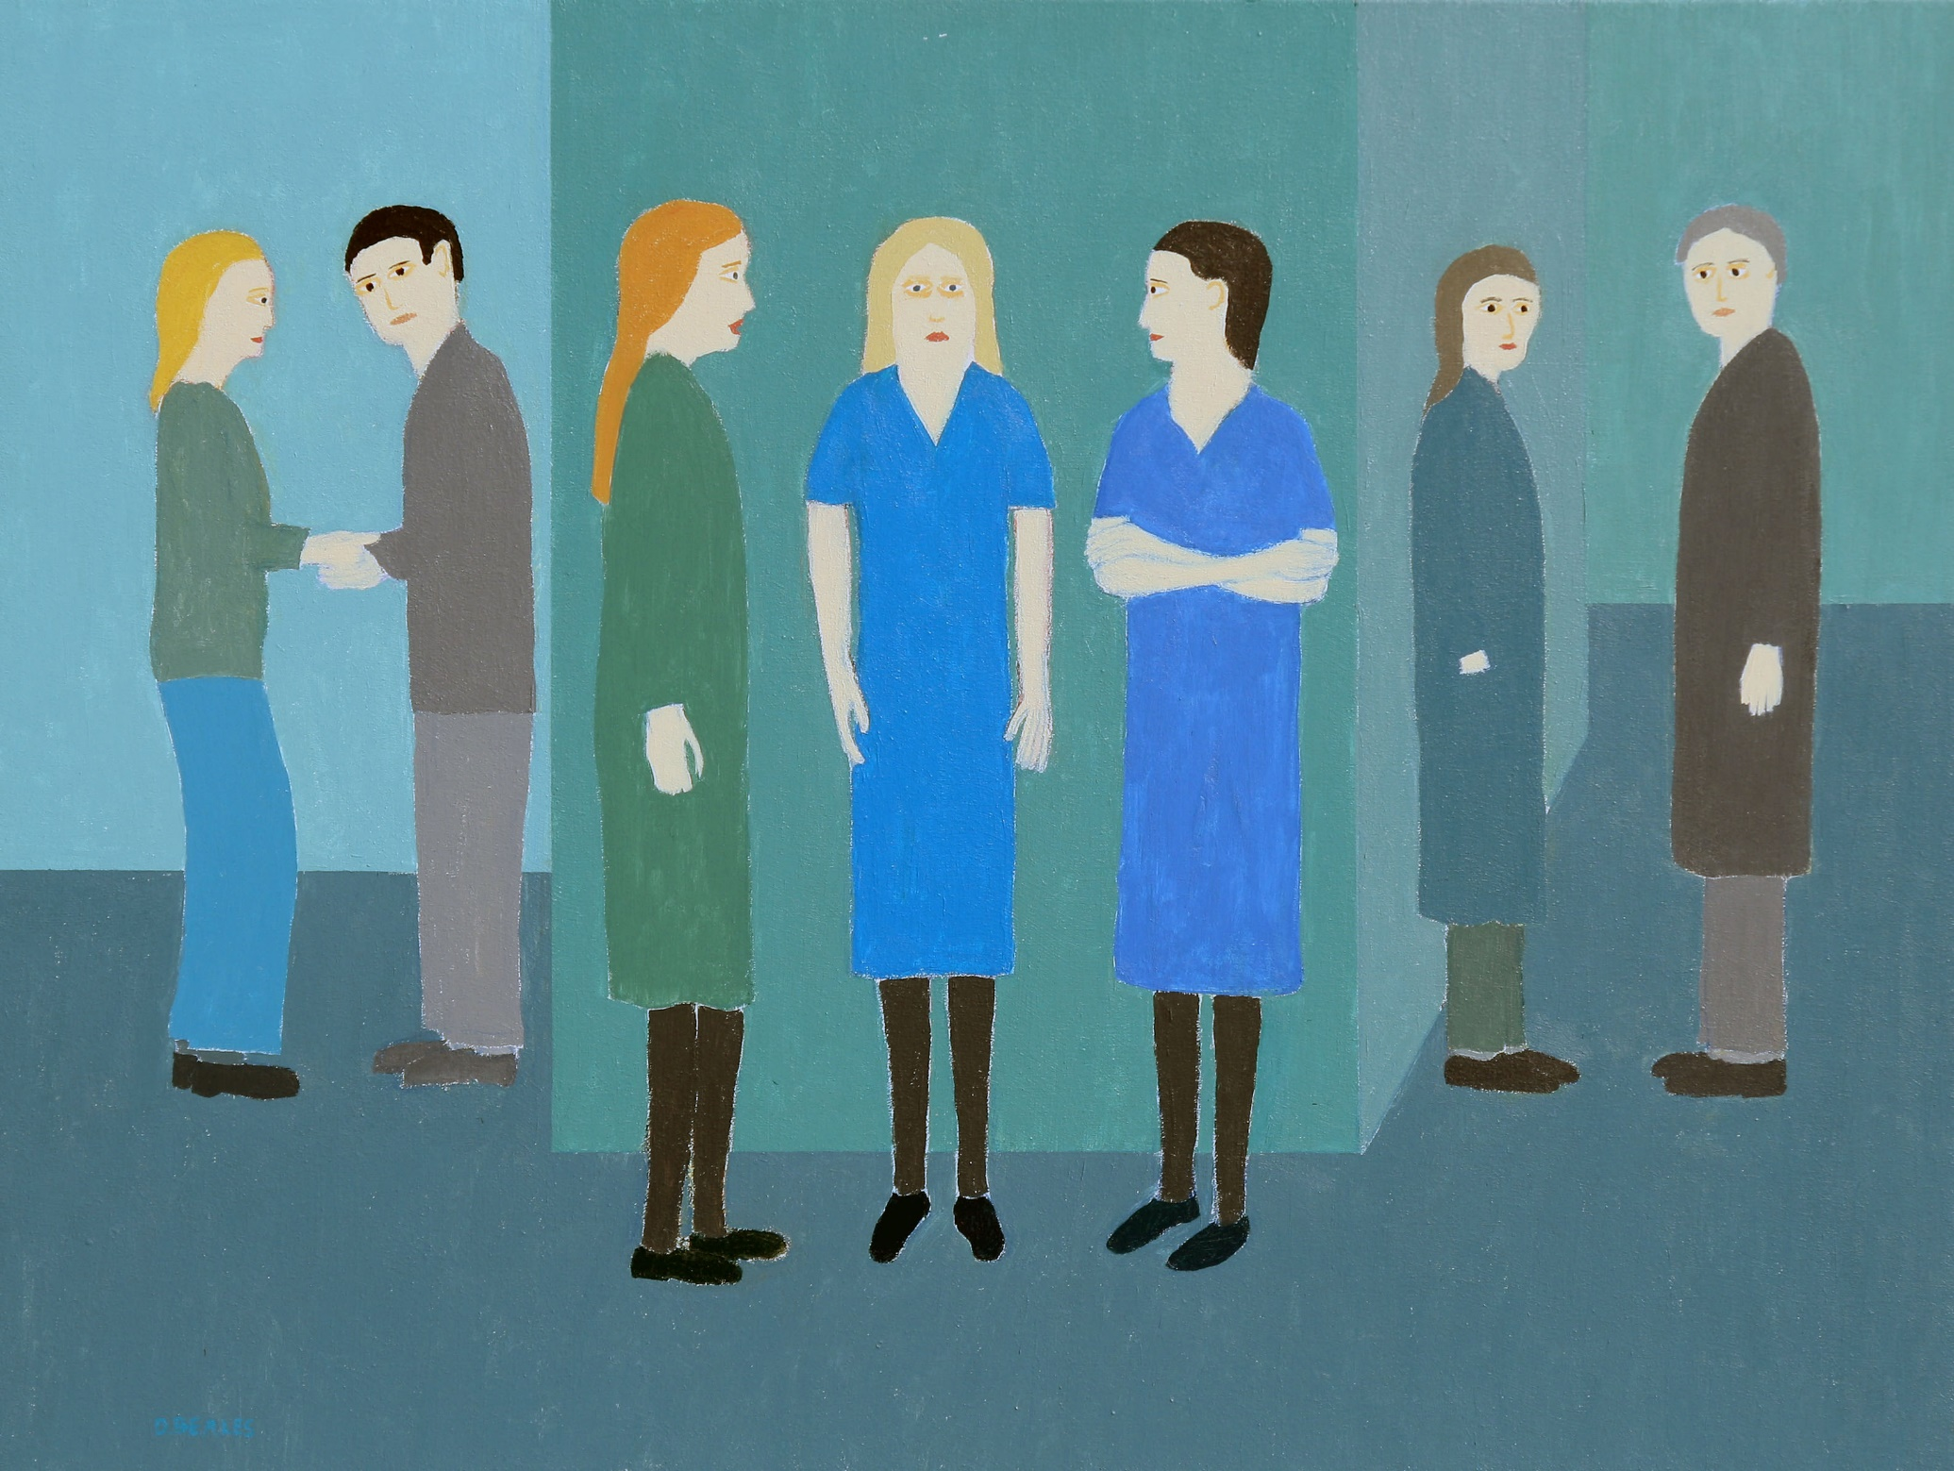

Slide 6
One of the hospital cats has wondered into the dormitory. The nurse is worried that one of the patients may be feeding them.

Slide 7
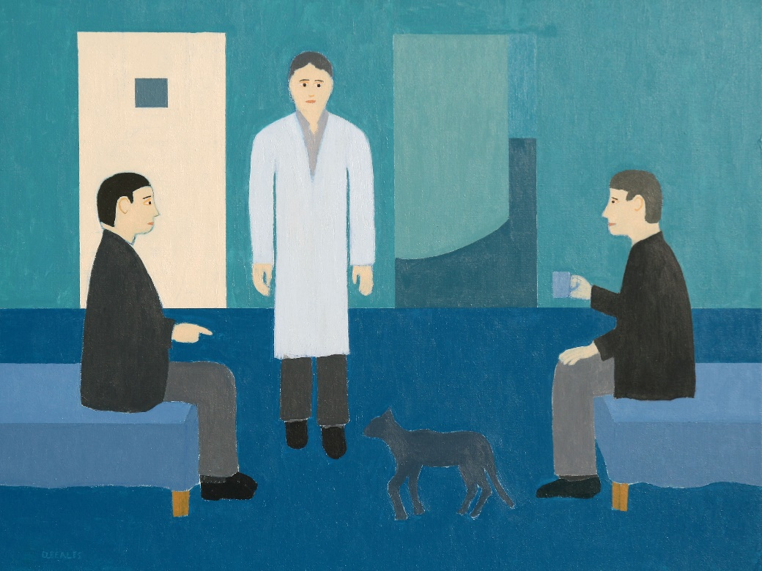

Slide 8
During the day most patients were required to attend The Industrial Therapy Unit. The top rate of pay in 1981 was about 15p an hour. Patients could supplement their £7 a week benefit allowance with a pay packet of between £2-£4.50 pence without losing money. The work areas were segregated. The work itself was simple, mainly packing jobs. The most complicated job was assembling ceiling roses.

Slide 9
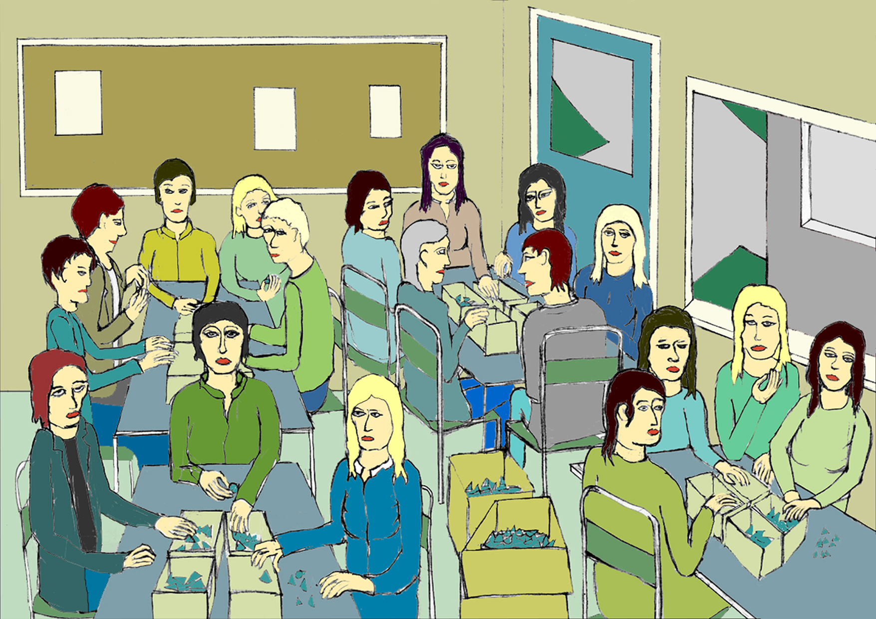

Slide 10
The queue formed, the patients collected their dinner from the serving hatch. A new patient on the admission ward was young, attractive, wore fashionable clothes, and was the victim of a nervous breakdown. She provoked staff jealousy. ’Why should ‘they’ have this why should ‘they’ do that ?’. When it came to her turn she asked the nurse who was working with the domestic staff behind the serving hatch, to make up the numbers, if she might just have one scoop of mash because she was on a diet. Rudely, unnecessarily she gave the new patient two mash, ignoring the request.

Slide 11
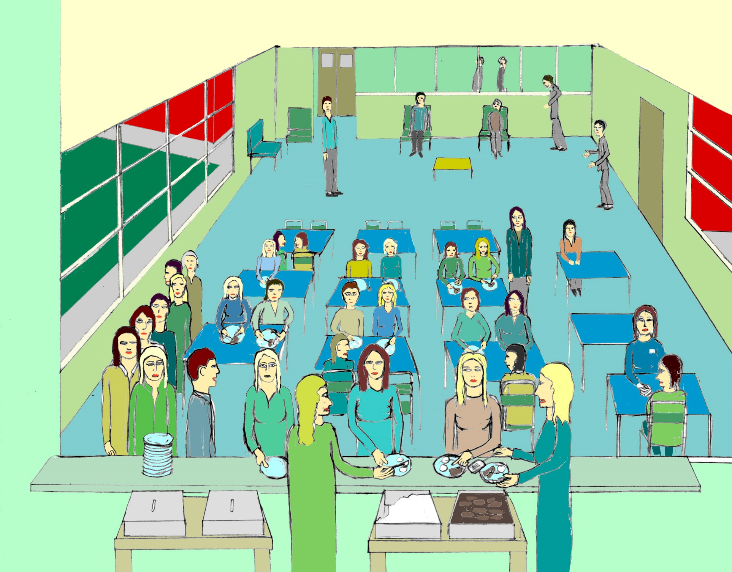

Slide 12
The admission wards were mixed, The patients could socialize in the day room. of tea of the day. Patients too ill to attend therapy could sit and watch television while the nurses assessed the new admissions.

Slide 13
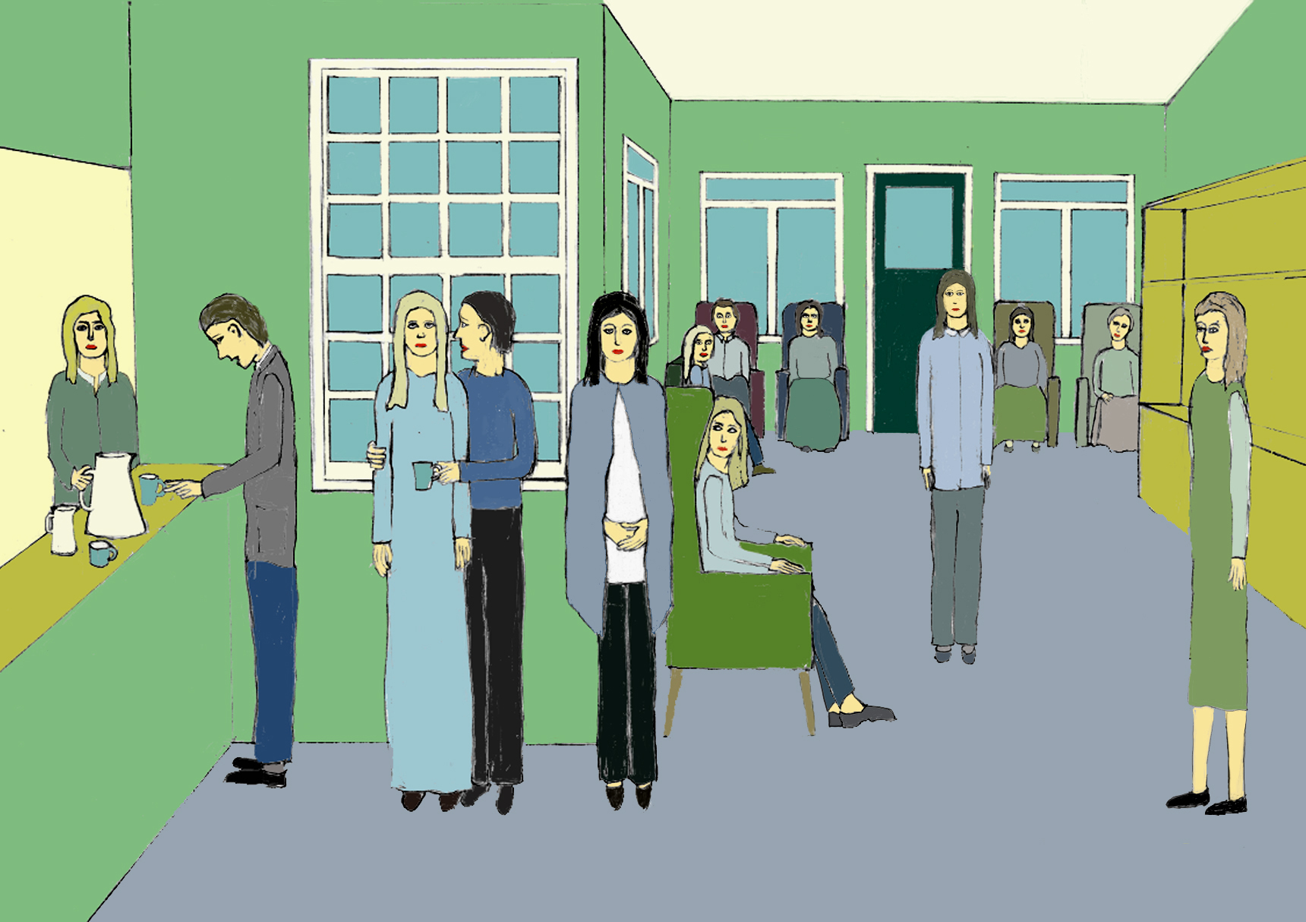

Slide 14
The wards in the old Victorian psychiatric hospitals were connected by corridors. Here patients could meet in relative privacy.

Slide 15
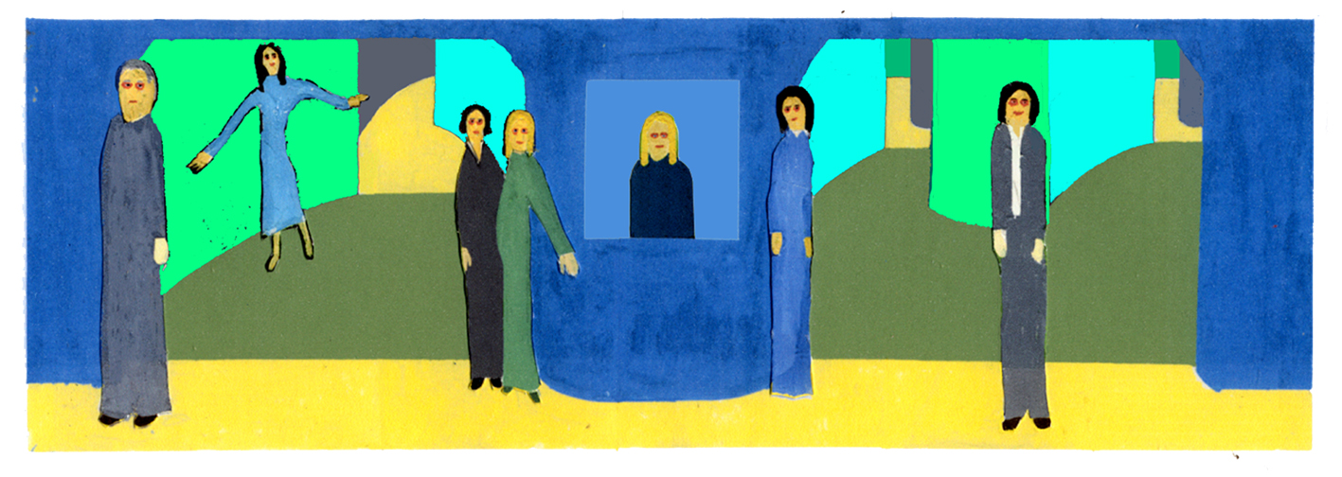

Slide 16
Some patients were reduced to smoking dog-ends. Two patients who spotted the same dog-end would race to pick it up, the loser harbouring resentment if he thought he had spotted it first.

Slide 17
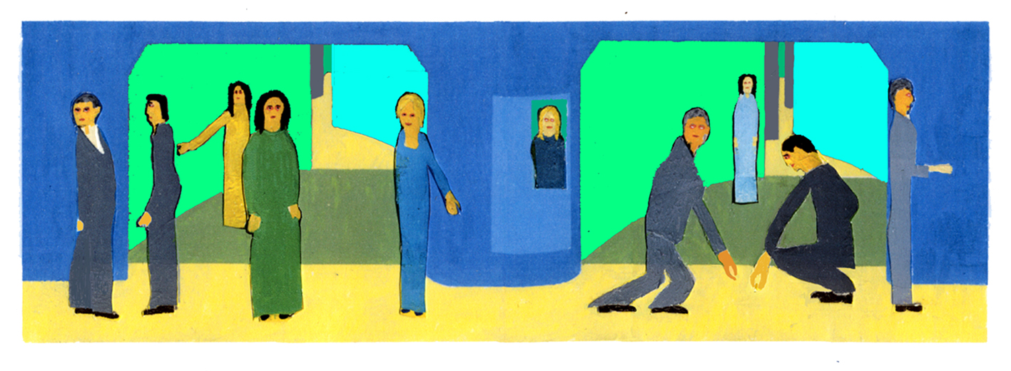

Slide 18
Some patients visit a kiosk in the corridors while another pushes a dinner trolley to the wards.

Slide 19
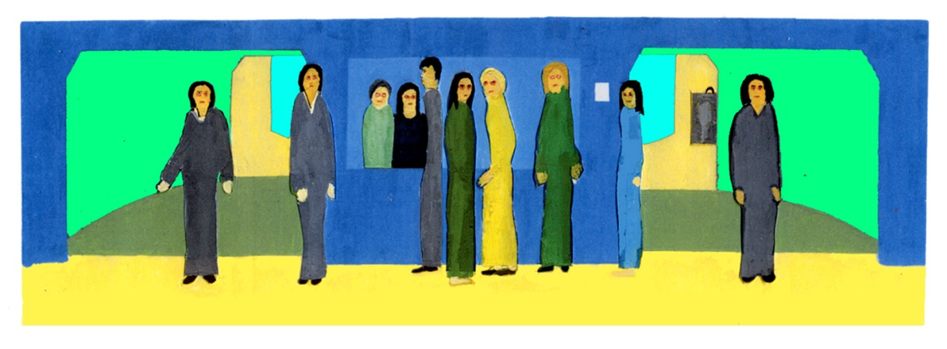

Slide 20
The hospital shop was a meeting place where the patients could socialize away from the wards and the staff. The medication and daily agenda of the hospital left little time for the prejudice and mean spirited behaviour society indulges in on a daily basis. Often the staff could intervene to stop quarrels. Patients would help each other but scroungers were usually discouraged. Any patient troubled by the voices that sometimes torment schizophrenic patients would find either a sympathetic ear or patient with a worse voice hearing experience to reassure them that they were not the only one to suffer from this symptom. The voice hearer in the community is ignorantly labelled potentially violent or bullied by society more intent on presenting a facade of competency than actually understanding and helping.

Slide 21
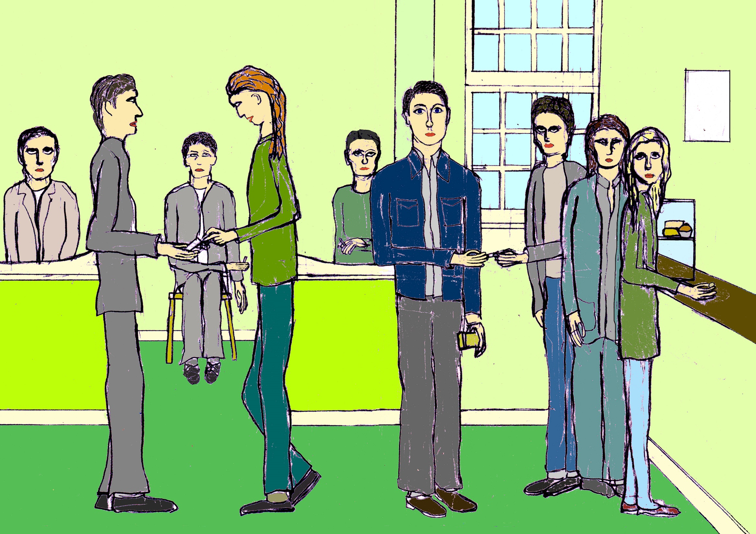

Slide 22
This is a day room in a female ward. Here the patients are drinking the hot drinks served on the ward at eight o clock in the evening.

Slide 23
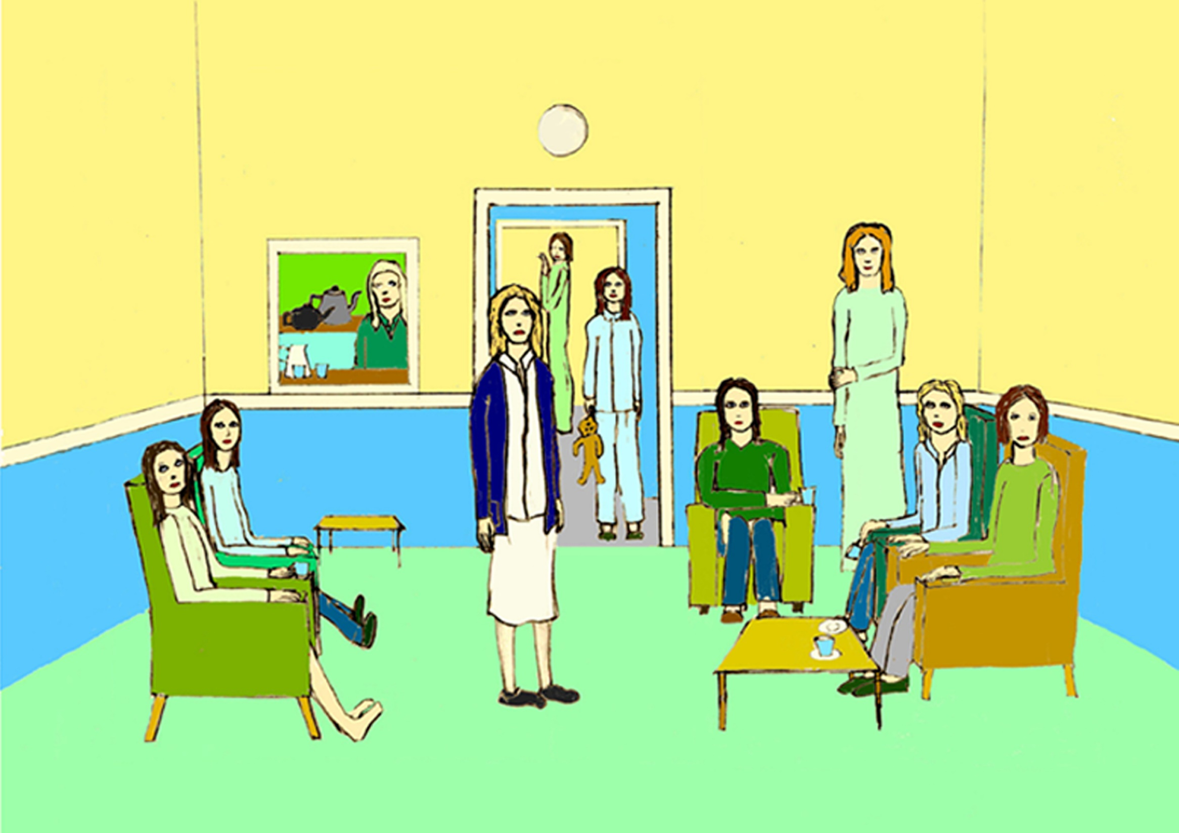

Slide 24
The dormitories on the old long stay wards were crowded and afforded little privacy. Patients had limited access to the kitchen during the day and it was locked at night so they bought tea bags and powdered milk and made tea from the warm water from the hot tap in the washroom. The water was not allowed to be too hot to stop patients scalding themselves.

Slide 25
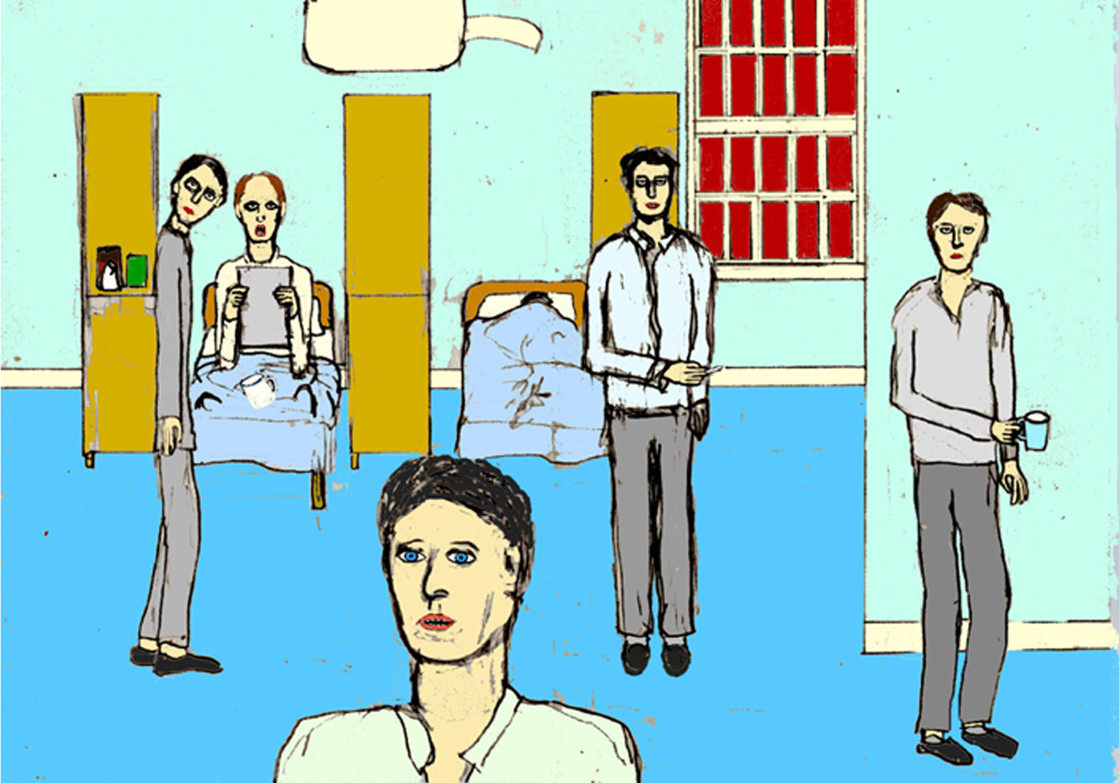

Slide 26
Night medication was given out at 10 p.m. The nurses staff wanted a quiet ward and so did most of the patients. Often patients who were asleep by this time were woken up to be given sleeping pills. If a patient is caught palming tablets they are given the drug in liquid form. The cry of ‘Tablet time’ echoed around wards from quarter to ten calling the patients to queue up in front of the medication trolley.

Slide 27
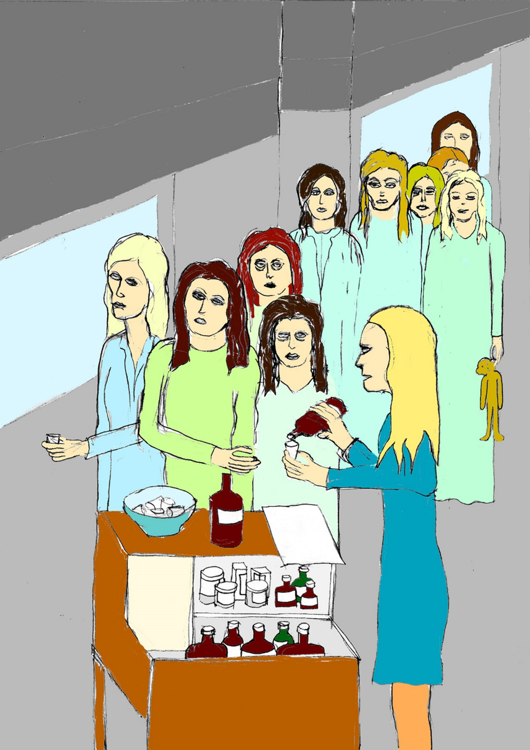

Slide 28
Some older patients had good memories of the hospital. There were three hot meals a day and in the evening the kitchen was left open on some wards. Old black and white films were shown in the main hall on Wednesday afternoon. In the evening there was a games night where patients were allowed to play their records and play dominoes, snakes and ladders, draughts and chess, or bingo night where patients played for a loose cigarette or a bar of chocolate a line, ten cigarettes for a full house. There were skittles matches against teams from other hospitals. In the summer there was a fete on the cricket pitch, with prizes for painting ,drawing, cakes, jam and tapestry, and cricket matches against other hospitals. There was a yearly trip to the coast, to Eastbourne , Brighton , or Hastings where the patients would roam the seaside town often as not ending up in the pub.

Slide 29
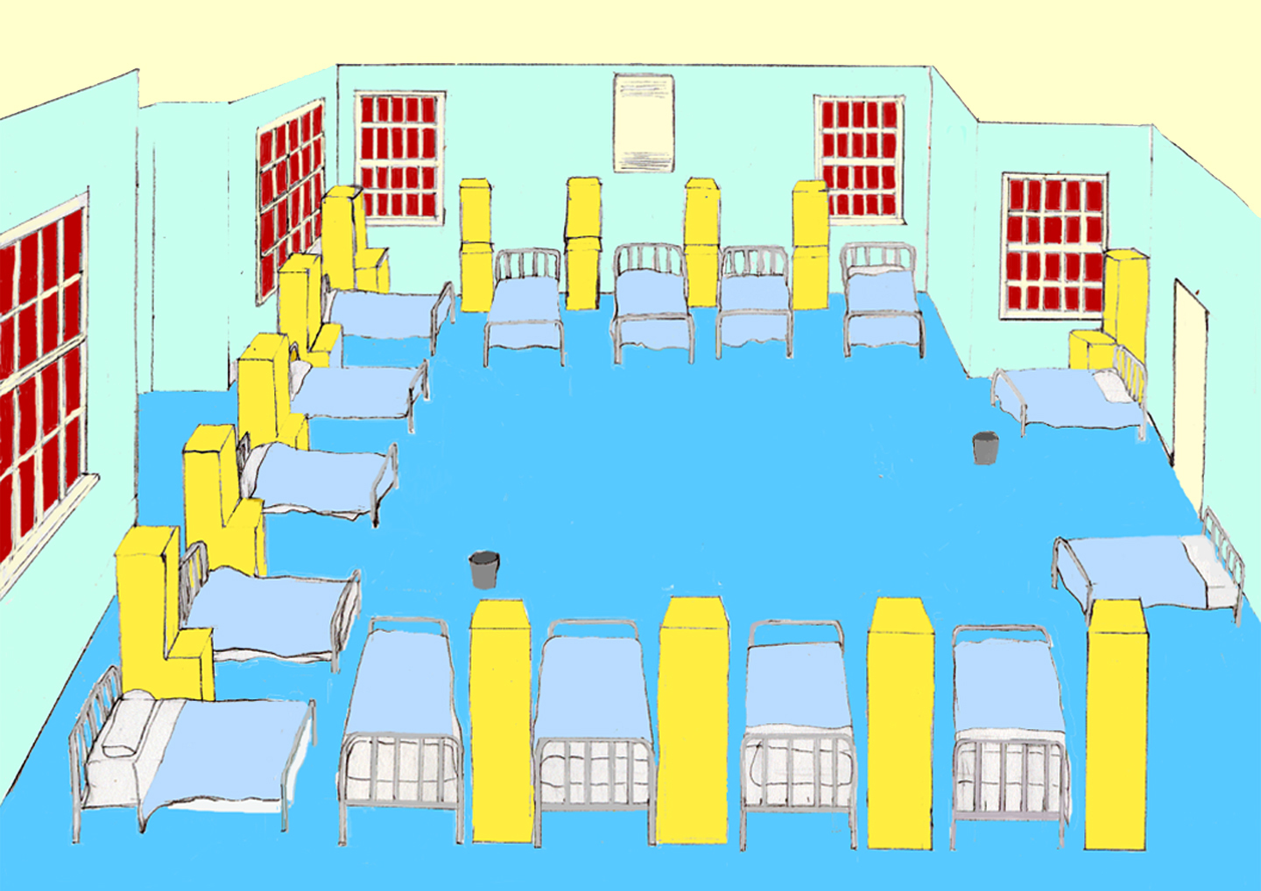

Slide 30
The End

