Slide 1
The Rake’s Progress
A Slide Show by David Beales

Slide 2
The Rake was overcome by loneliness and took refuge with the addicts. They seemed friendly, welcoming him into their company once he had reassured them that he was not a plainclothes policeman. They even offered him a free fix of heroin, and he accepted. He enjoyed the effect of the drug, and felt initiated. ‘I would like to buy some heroin’ he announced to his new friends and they smiled to each other as one of them asked how much would he be requiring.

Slide 3
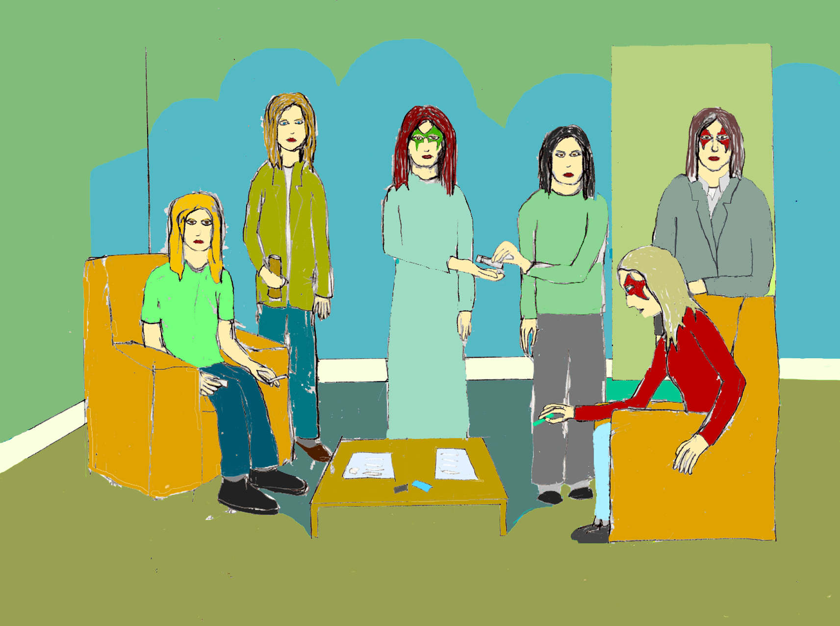

Slide 4
After a while the heroin user drifts into addiction with its attendant tragedies

Slide 5
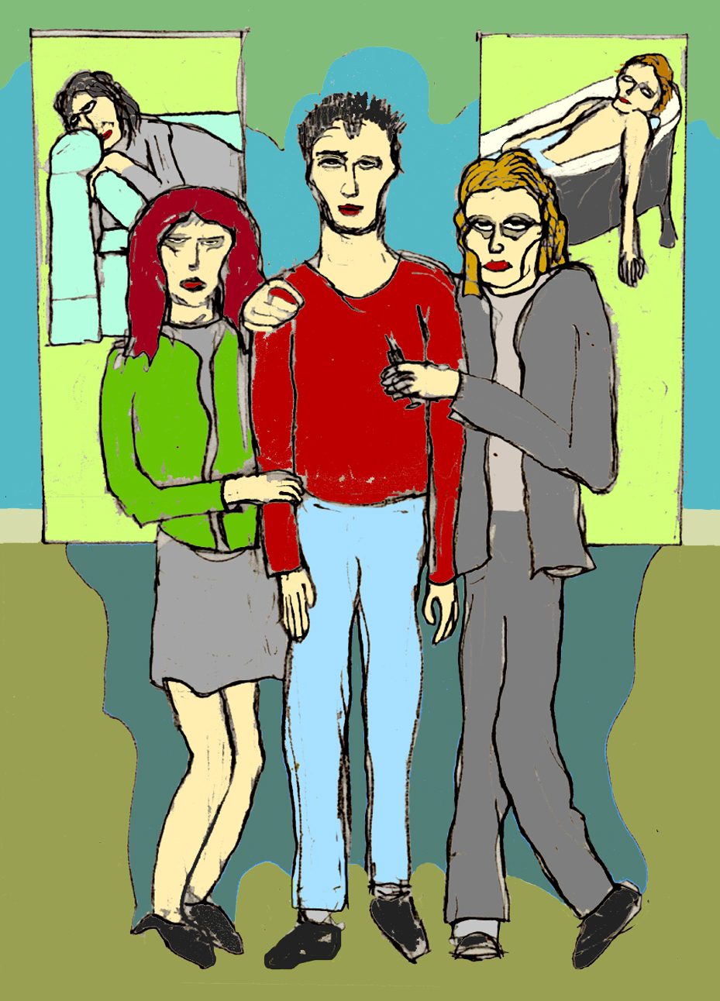

Slide 6
Sometimes the scenes are sordid. Here a naïve drug user is used as a pincushion for sport

Slide 7
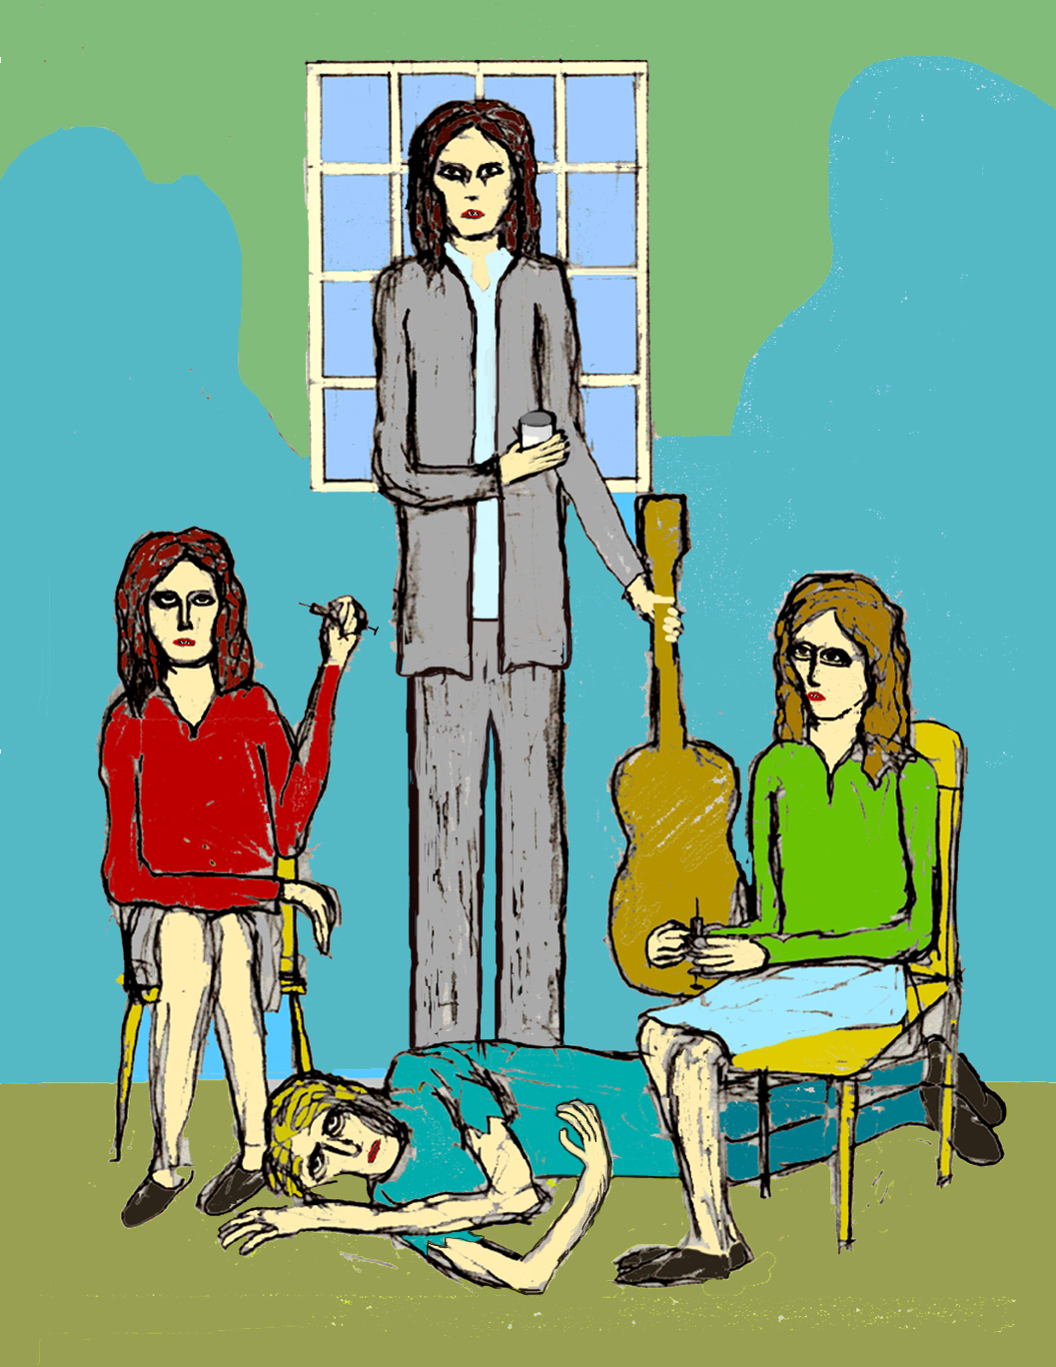

Slide 8
The Rake was high, but still alone. He decided to go to a concert. At the concert he met a young woman who recognised as also being a drug user. Soon they were a couple, she moved in with him and they shared the chores. They also continued to use covering for each other when they ran out of heroin.

Slide 9
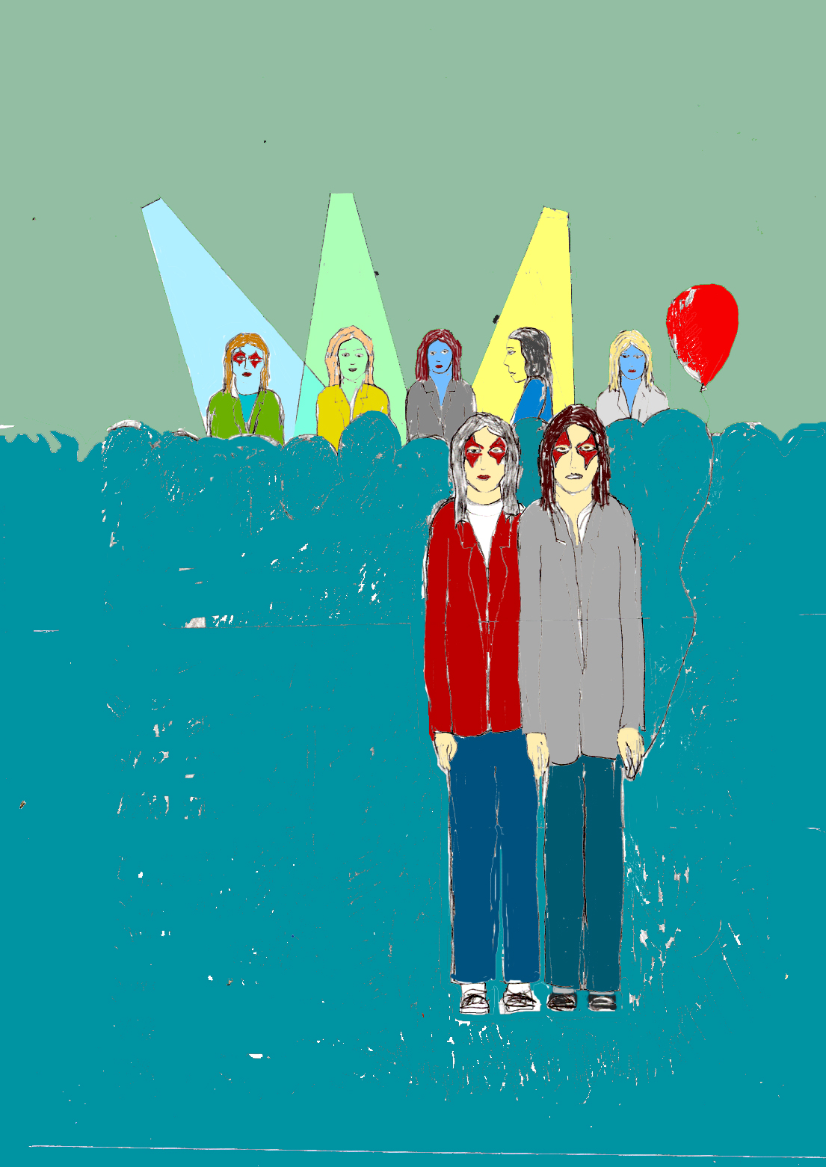

Slide 10
The Rake became addicted but ran out of money. So he went to the dealer and threw himself on his mercy. The dealer did not seem in the least bit surprised at the Rakes problem. ‘I have some kittens and can find no home for them. If you could see your way to drowning said kittens, I will pay you in kind, a small amount of heroin to last you until you find some money‘.

Slide 11
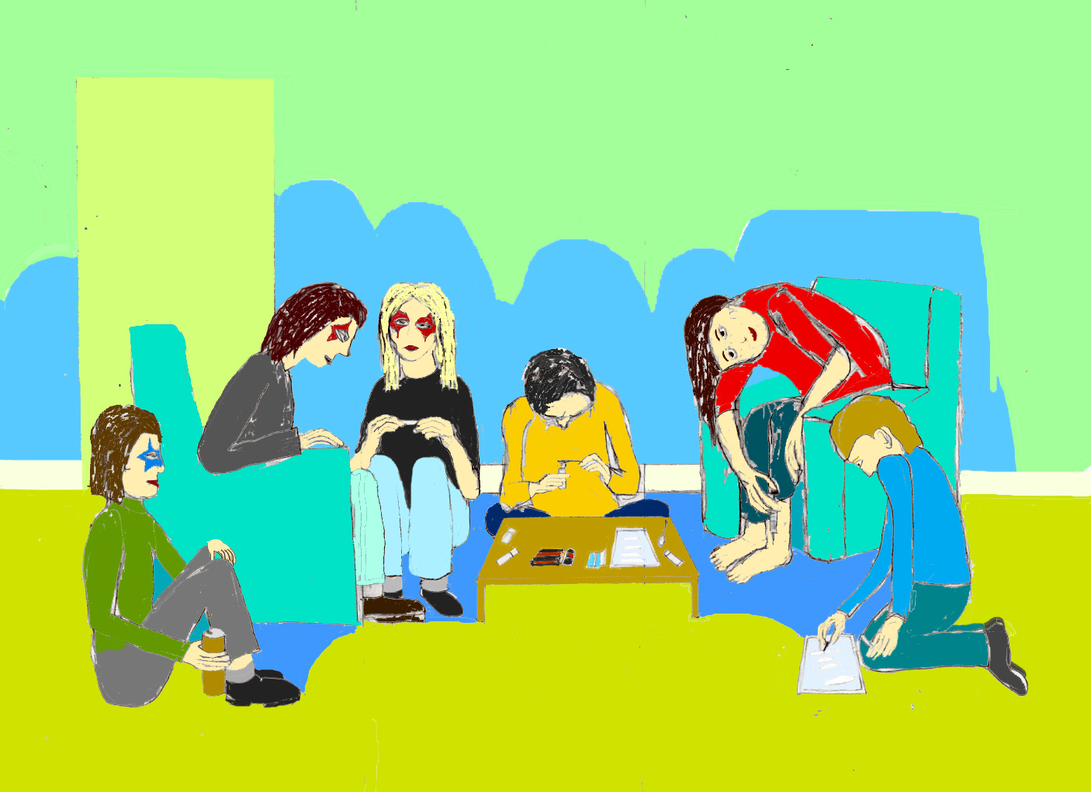

Slide 12
‘Drown the kittens, not in the bath at home, no need for anyone to know.’ The Rake said to himself. He made his way down to the underground river and did the wicked deed, saving a kitten as present for his girlfriend.

Slide 13
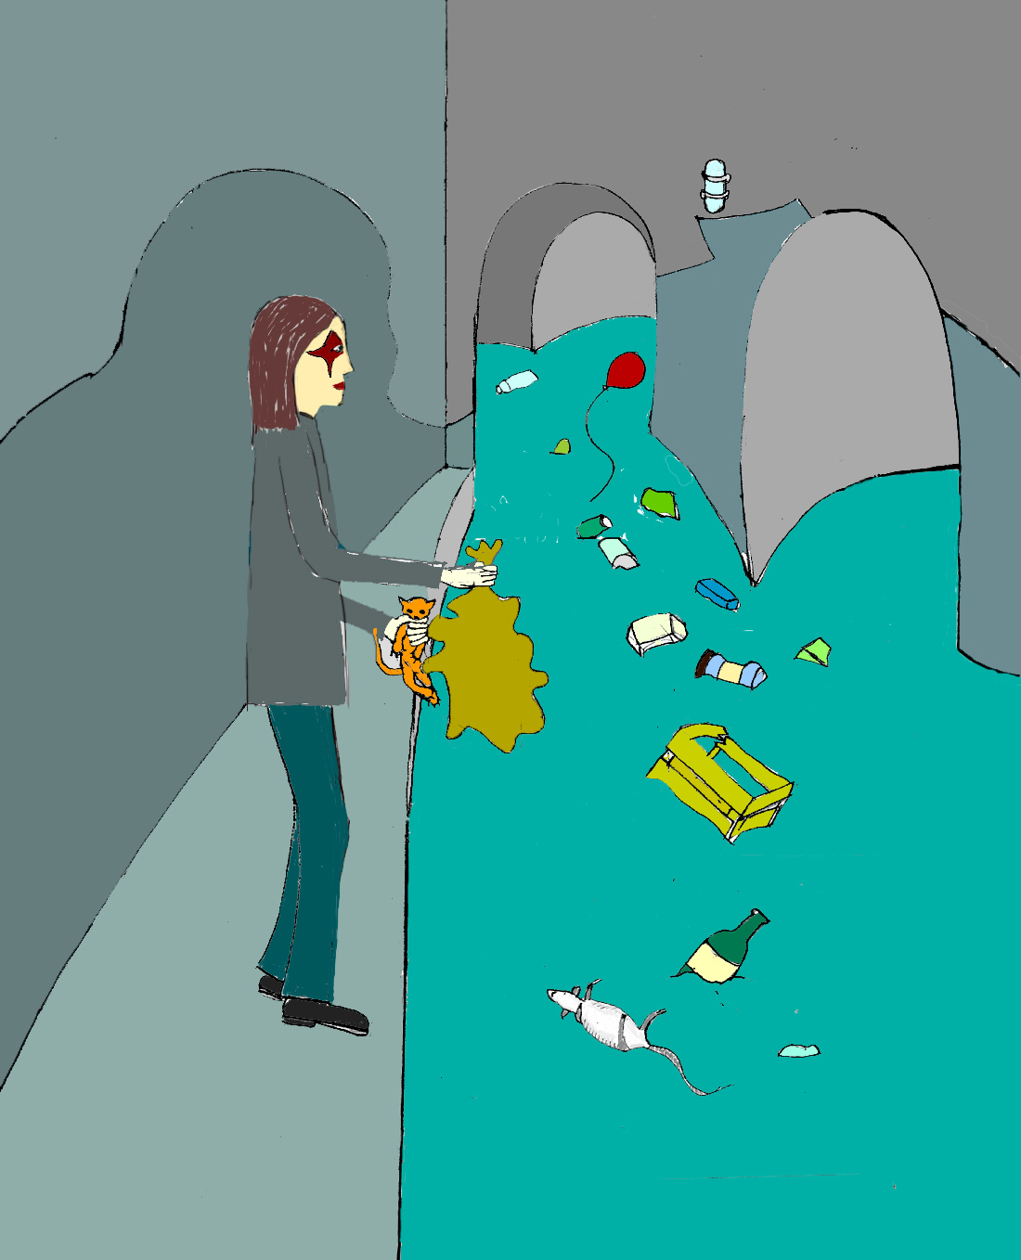

Slide 14
Desperate for money to buy drugs the Rake and his girlfriend went out mugging. They waited for a suitable victim. A young girl, mentally a bit young for her age was walking towards the Rake and his girlfriend holding a purse in one hand and a teddy bear in the other. This is providence thought the Rake who threatened the girl with a knife, and took her purse. Run said the Rake to his girlfriend, and when they felt they were far enough from their victim they opened the purse to find a £20 note.

Slide 15
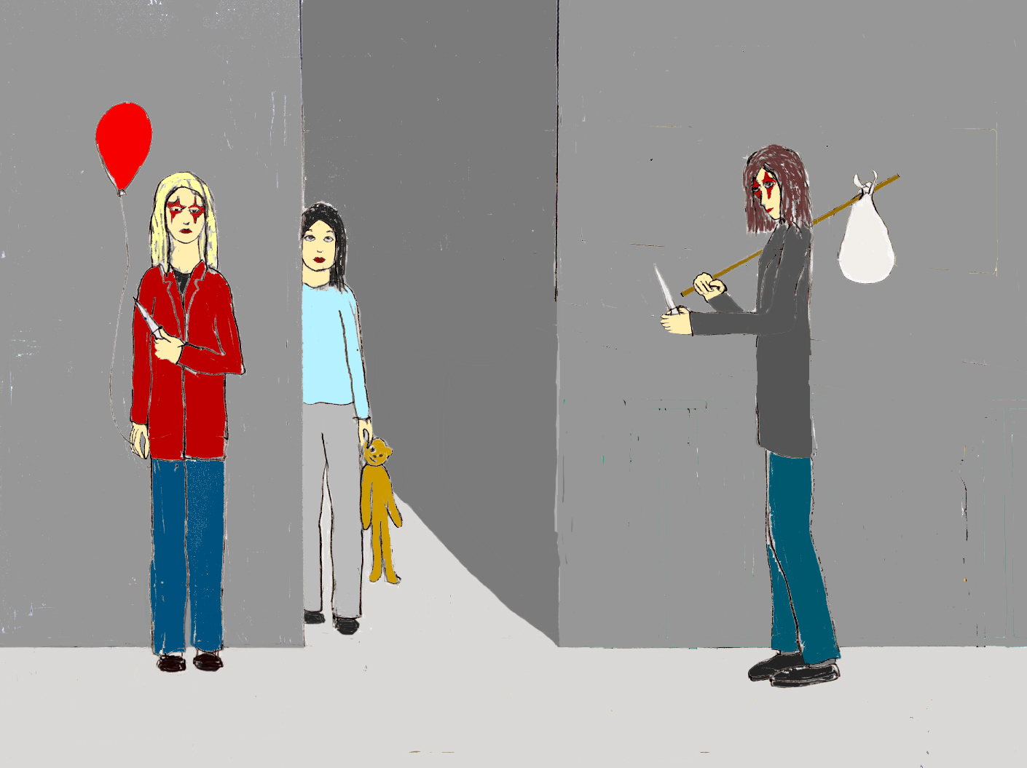

Slide 16
And still the rake was obliged to return to the local drug den to score. The dealer was not pleased with the Rake for wanting such small amounts. I will give you more but you will have to pay me by Friday and have enough to buy the same again.

Slide 17
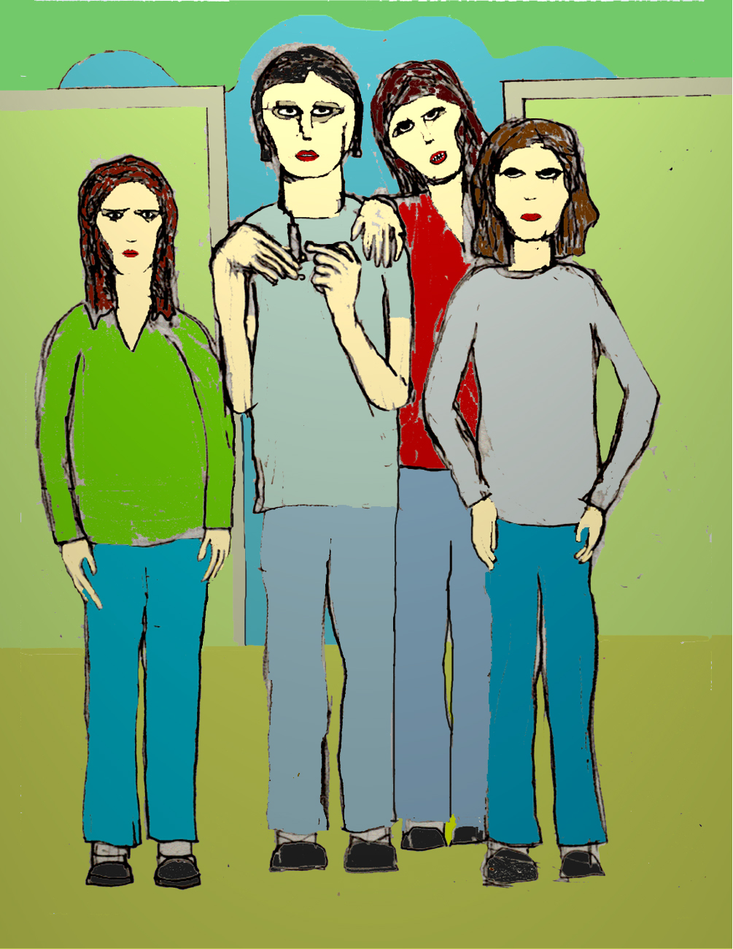

Slide 18
I will try to rip off some customers by dealing on the street, but I wont be able to do that for long maybe only once or twice. Word gets around. You will have to go on the game until something turns up. At first the Rake’s girlfriend refused. Then he suggested they mug the customers. Tell them they have to come back to your place and I’ll be waiting around the corner. But after a while she went with the customers in their cars.

Slide 19
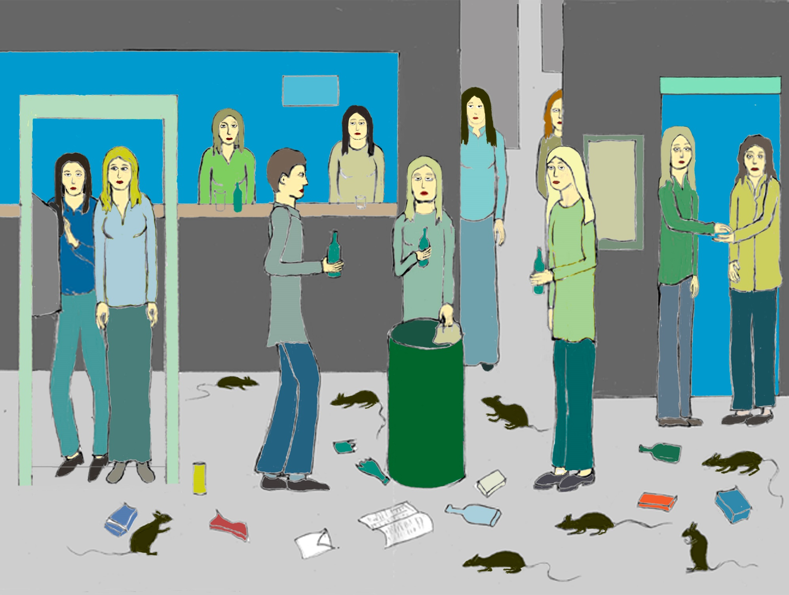

Slide 20
For a while the Rake’s girlfriends immoral earnings, and their benefit payments kept them in heroin. The Rake noticed that the dealer and his customers were too sick to say much.
One night the Rake and his girlfriend tried to socialise, attending a seedy party in the back streets, but they felt alienated and went home despondent.

Slide 21
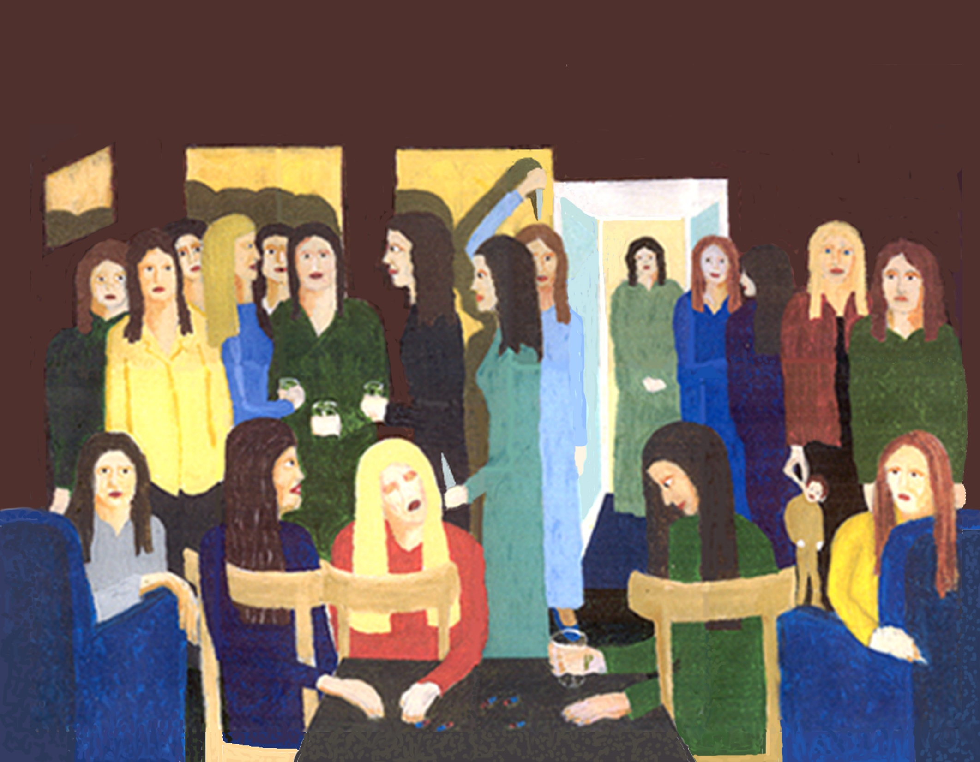

Slide 22
They were both sick. On the way back from the party the Rakes girlfriend suggested that they walk back by the river, perhaps walk over the bridge. ‘While we‘re still high’, she said. The Rake knew why.

Slide 23
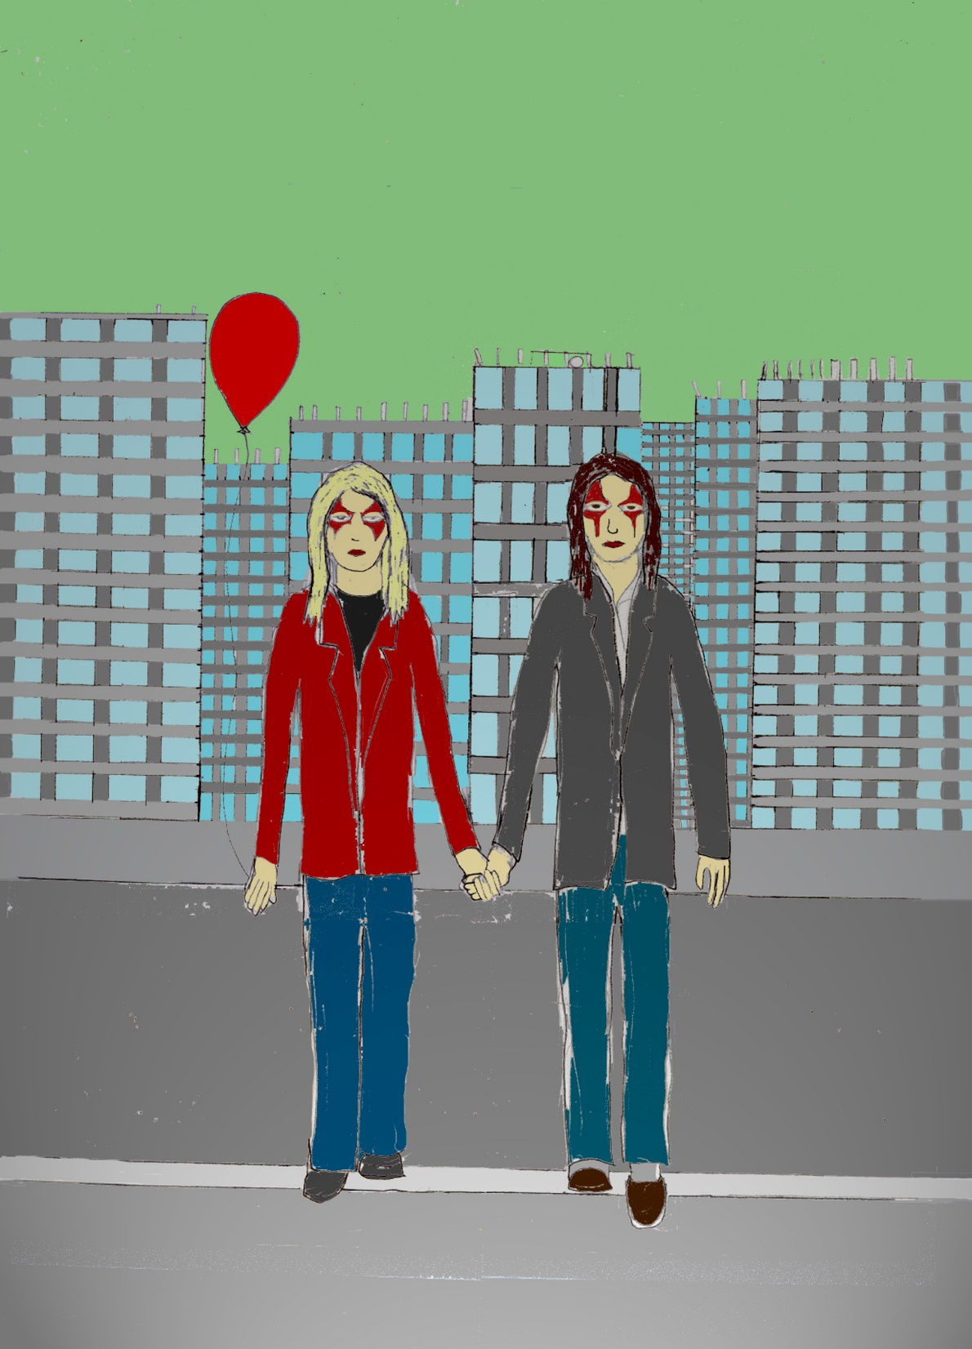

Slide 24
They were so preoccupied with their misery that they did not notice an off duty police officer who was watching them jump from the road that ran by the river. He jumped in to try and save them, but the Rake’s girlfriend was swept away by a strong current. He reached the Rake. ‘Don’t struggle or we’ll both drown’. The Rake was glad to be saved. ‘I’m alright now, I can make my way home’. ‘Its not as simple as that‘, said the off duty policeman. ‘Taking part in a suicide pact is a crime and so I have to place you under arrest’. His girlfriend was not so lucky, her dead body was found washed up on the riverbank a couple of miles up the river.

Slide 25
The End

